Slide 1
Employee Data Analysis using Excel
STUDENT NAME:GOPIKA.G
REGISTER NO:312209413
YEAR: 3
DEPARTMENT:B.COM ( ACCOUNTING & FINANCE)
COLLEGE: ANNA ADARSH COLLEGE FOR WOMEN

Slide 2
PROJECT TITLE
Employee Performance Analysis using Excel

Slide 3


AGENDA
Problem Statement
Project Overview
End Users
Our Solution and Proposition
Dataset Description
Modelling Approach
Results and Discussion
Conclusion
3/21/2024 Annual Review

Slide 4

PROBLEM STATEMENT
TO conduct a concise employee performance analysis
DATA ENTRY : record employee details .name ,ID , department,
Include performance mertics
METIRCS CALCULATIONS: calculates performance score by weighted
DATA ANALYSIS : RANK employee using the rank function , analyze trend
With charts and pivot tables
VISUALIZATION: use pivot table summarize performance by department or
Time period
REPORTING: IDENTIFY top perform for promotion ,highlight areas needing
improvement

Slide 5

PROJECT OVERVIEW
.
DATA COLLECTION: Gather employee details and performance metrics(sales ,
Project, feed back
VISUALIZATION: USE bar charts and pivot tables to compare performance and
Summarizes data
REPORTING: Summarize key finding recommend promotion or training based on
Performance data

Slide 6

WHO ARE THE END USERS?
1.HUMAN RESOURCES (HR)
2. MANAGER \ SUPERVISORS
3. EXCUETIVES
4.EMPLOYEE
5. EMLOYER

Slide 7

OUR SOLUTION AND ITS VALUE PROPOSITION
COST EFFECTIVE : Utilizes excel reducing the need for additional software
Investment
CUSTOMIZABLE: Easily adapts to specific business needs and performance metrics
DATA DRIVEN : Enables informed decision on promotion and training through
Clear objective analysis
TRANSPARENCY :ENSURES FAIR AND CONSISTENT PERFORMANCE EVALUATION
ENGAGEMENT: PROVIDES ACTIONABLE FEED BACK

Slide 8
Dataset Description
FIELDS: employee ID ,name ,department ,job role ,tenure
SALES: totals sales figure
Project completion : Number and percentage of completed project
FEEDBACK : rating from client or peer and punctuality
ATTENDANCE: Attendance record and punctuality
PERFORMANCE SCORE: Weighted composite score based on the above metrics

Slide 9

THE "WOW" IN OUR SOLUTION
=IFS (J4>5,”high”,J4>3,”MED”,”TRUE”,”LOW”)
3/21/2024 Annual Review
9

Slide 10
MODELLING
DATA COLLECTION: Gather data like KPL ATTENDANCE , project completion and feedback
DATA ENTRY: Input this data into an excel spreadsheet with column for each metric and
row for each employee
PERFORMANCE SUMMARY: USE CONDITIONAL FORMATTING to highlight high and low performs
VISUAL REPRESENTATION: create charts (like bar graph or radar to charts ) to visualize individual
And team performance trend
10

Slide 11
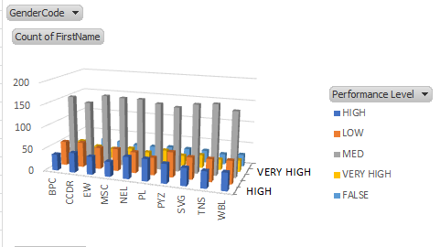
RESULTS
11

Slide 12
conclusion
THE CONCLUSION OF MY PROJECT WAS
The topics of my project was EMPLOYEE PERFORMANCE ANALYSIS USING EXCEL
IN THIS PRESENTATION I has given the project comparisons by excel formulas ,conditional
formatting and charting tools ,you can gain valuable insight into employee strengths and
Areas needing improvenment

